Slide 1

BS Data Science
2nd Semester
Chapter # 4
Applied Physics
Presented By
Arifa Mirza
Punjab University College of Information Technology

Slide 2
Chapter Contents
Electric potential energy
Electric potentials
Calculating the potential from the field and related problem
Potential due to point charge
Continuous charge distribution
Potential due to dipole
Equipotential surfaces
Calculating the field from the potential.

Slide 4


Electric potential energy

Slide 5
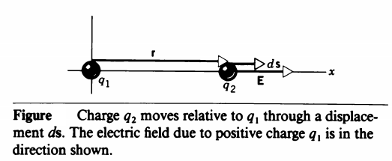
We can associate a potential energy with any system in which a charged particle is placed in an electric field and acted on by an electrostatic force.

Slide 6
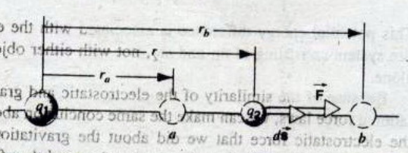

Slide 7



Slide 8




Slide 9



Absolute electric potential energy

Slide 10
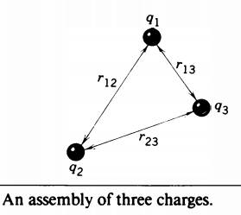

Electric potential energy of collection of point charges

Slide 11


Slide 12


Electric Potential

Slide 13


Potential due to a Point charge

Slide 14



Slide 15



Slide 16
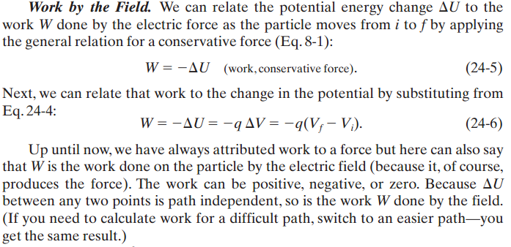

Slide 17
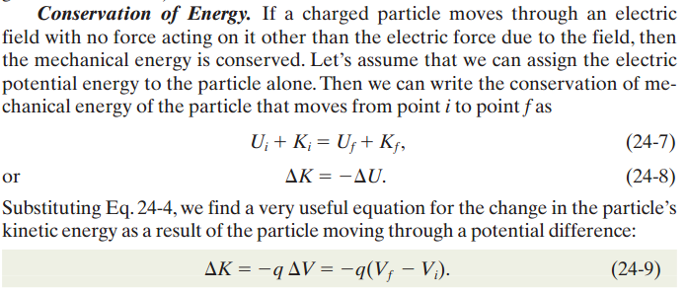

Slide 18


Slide 19
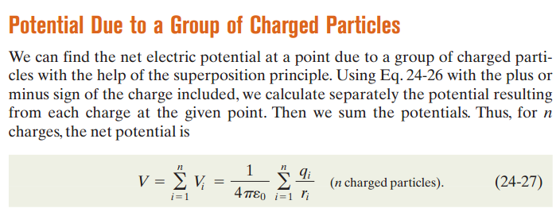

Slide 20

Potential due to an electric dipole

Slide 21
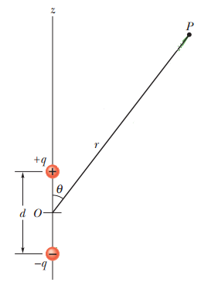

Slide 22
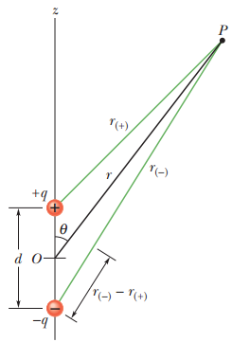

Slide 23



Slide 24
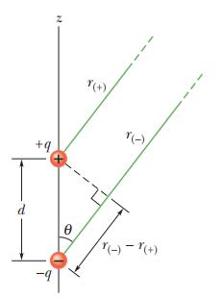
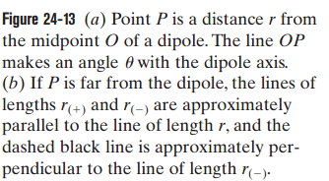

Slide 25
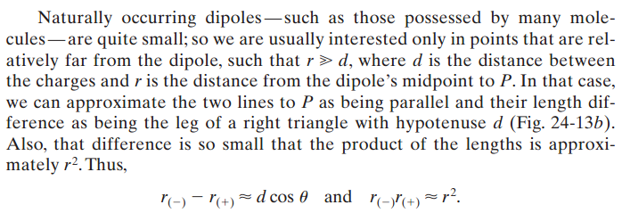

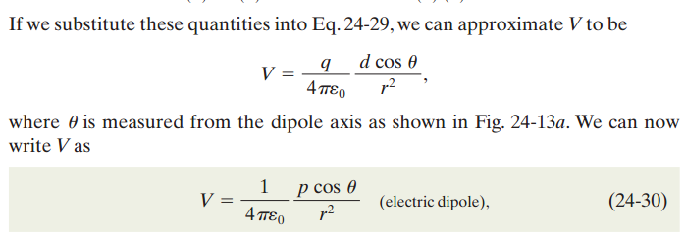

Slide 26
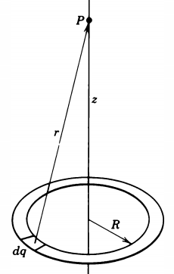
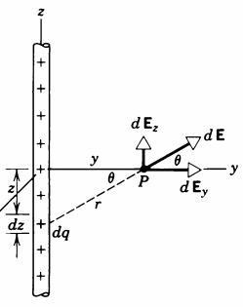
Potential due to continuous charge distribution

Slide 27
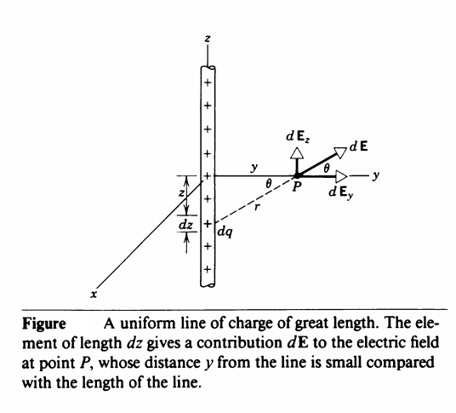
Uniform Line of Charges

Slide 28
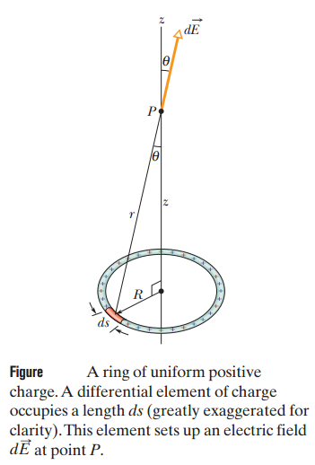
Uniform Ring of Charges

Slide 29
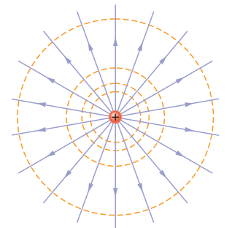
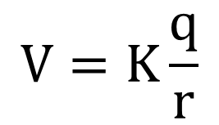
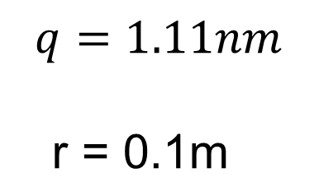
Equipotential surfaces
V = 100 V

Slide 30
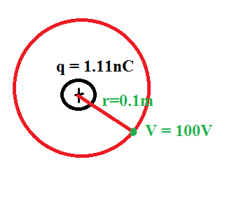

Slide 31
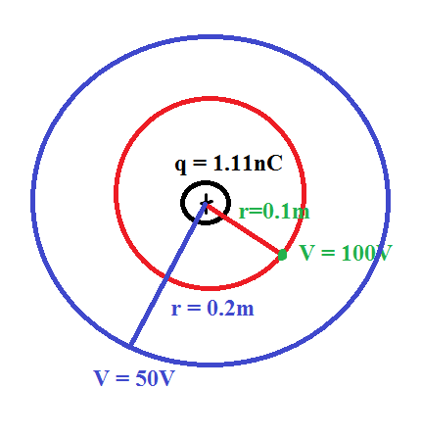

Slide 32
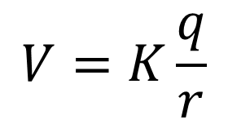



Equipotential surfaces
A positive point charge,

Slide 33
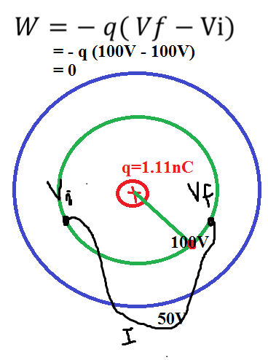


Slide 34
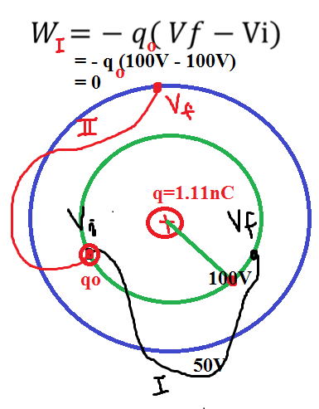

Slide 35
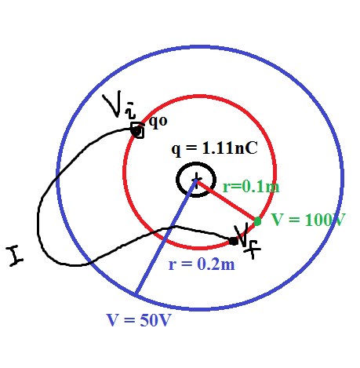
Similarly

Slide 36
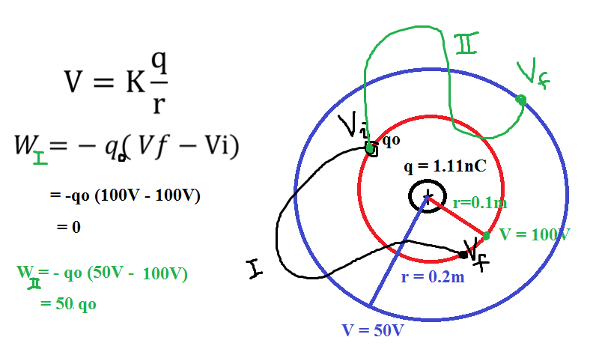

Slide 37
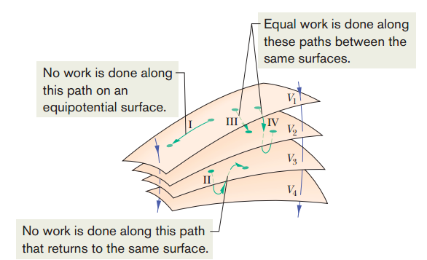

Slide 38
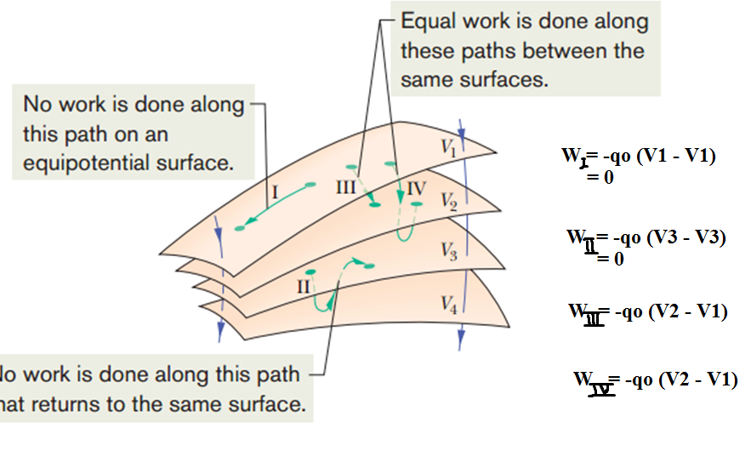

Slide 39
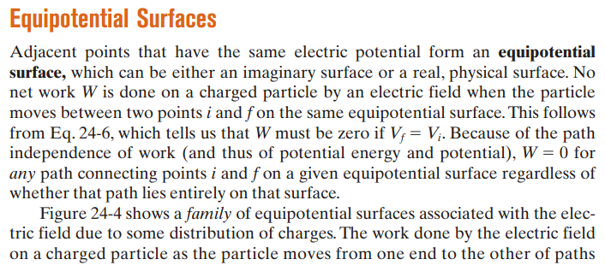

Slide 40


Slide 41
Electric field lines are always perpendicular to the equipotential surfaces.

Slide 42
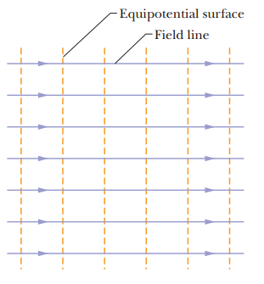
Electric field lines are always perpendicular to the equipotential surfaces.

Slide 43
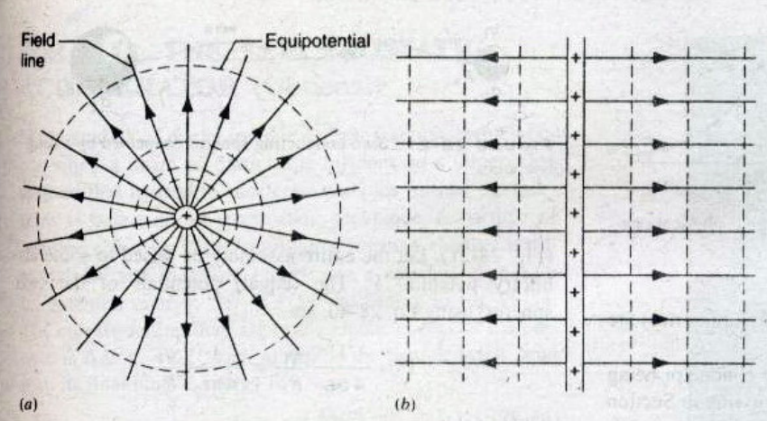

Slide 44
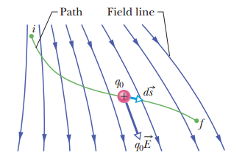
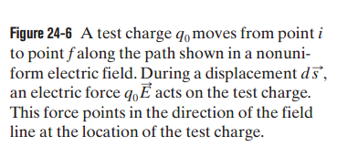
Calculating the potential from the field

Slide 45
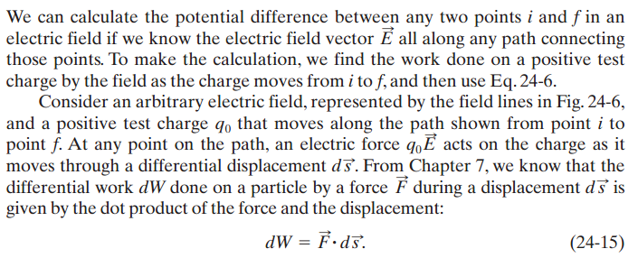


Slide 46




Slide 47
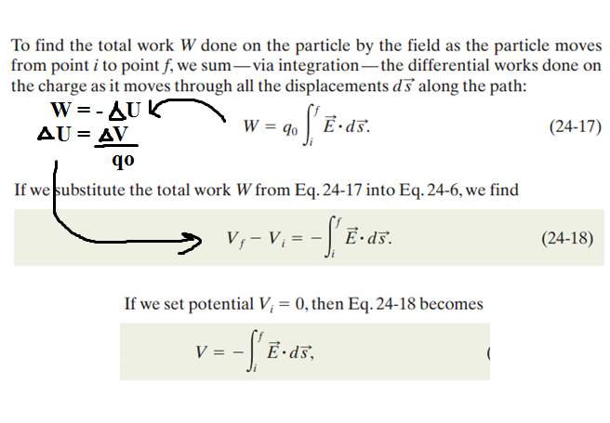

Slide 48

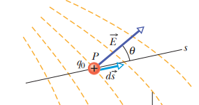




Calculating the field from the potential

Slide 49


Slide 50
